Slide 1




Securing Container Workloads Build, Sign, Scan, Push, Deploy & VNets
Oh My
Steve Lasker
Program Manager
Azure Container Registries
Steve.Lasker@Microsoft.com
@SteveLasker
SteveLasker.blog
https://github.com/stevelasker

Slide 2
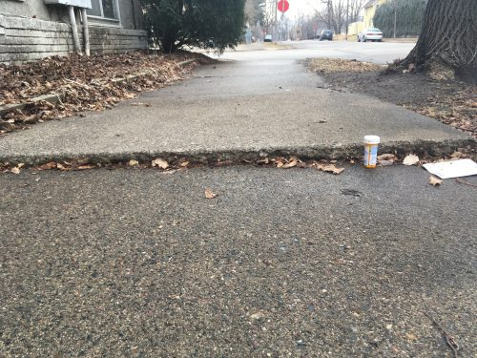
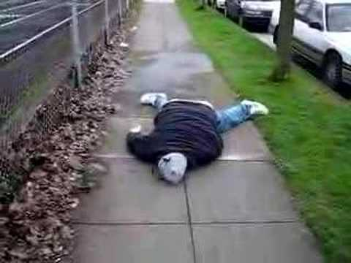
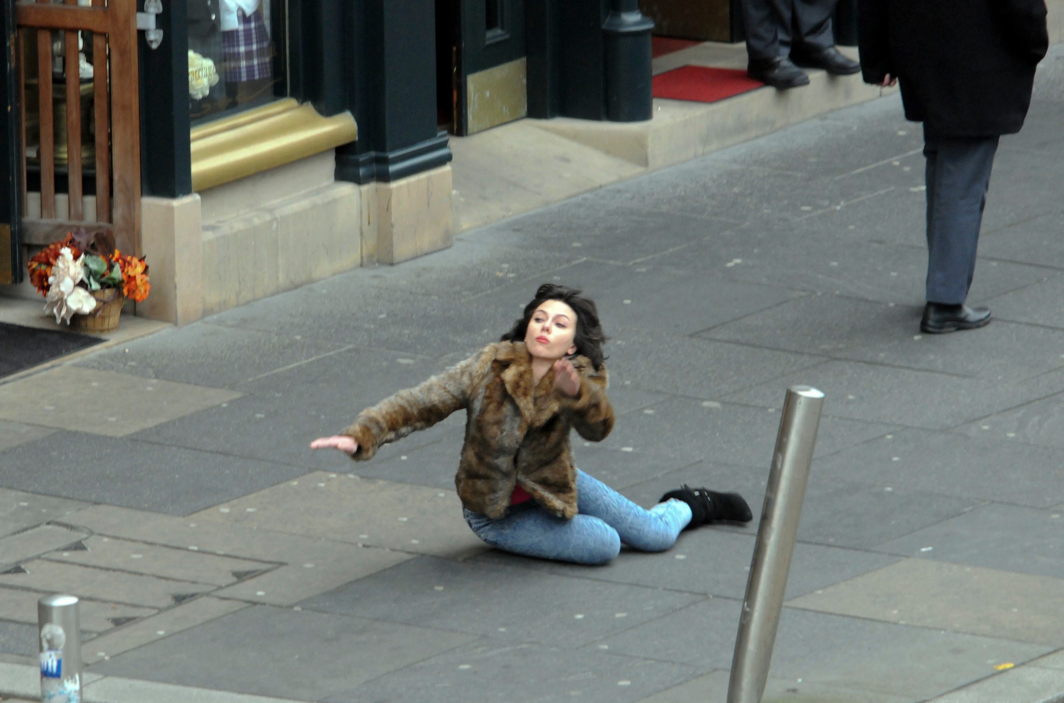
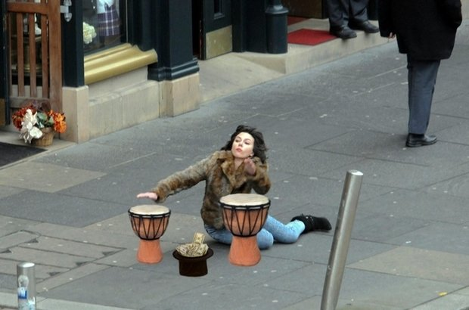
Container Orchestration & Reliability
Designing with the knowledge something will fail at any point

Slide 3

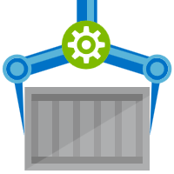

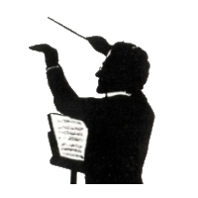
Orchestration Provides Infrastructure Resiliency
Release Management
Resource Pool
Orchestration
HOST-A
Deploy:
web:1 x3
quotes:1 x3
important:1 x4
Image Cache
web:1
digest: 91e
web:1
digest: 91e
Foo:
web:1 x3
quotes:1 x3
important:1 x4
web:1
digest: 91e
quotes:1
digest: u82
Container Builder
Container Registry
important:1
digest: 2re
important:1
digest: 2re
HOST-B
Image Cache
quotes:1
digest: u82
quotes:1
digest: u82
quotes:1
digest: u82
web:1
digest: 91e
important:1
digest: 2re
important:1
digest: 2re
important:1
digest: 2re
quotes:1
digest: u82
quotes:1
digest: u82
docker build –t web:1
docker build –t quotes:1
docker build –t important:1
docker push web:1
docker push quotes:1
docker push important:1
important:1
digest: 2re
important:1
digest: 2re
Image
web:1
quotes:1
important:1
web:1
digest: 91e
HOST-C
quotes:1
digest: u82
Image Cache
important:1
digest: 2re
quotes:1
digest: u82
quotes:1
digest: u82
important:1
digest: 2re
important:1
digest: 2re
Notes:
Orchestrator icon from: http://cdn.marketplaceimages.windowsphone.com/v8/images/f58edb21-b20c-4315-b837-6cee21n442cd?imageType=ws_icon_large
https://git-scm.com/book/en/v2/Git-Branching-Basic-Branching-and-Merging

Slide 4
What are the components of a secured workflow?
Where do you start?

Slide 5
Multiple lines of defense
Authentication & Authorization
Image Buffering
Image Patching
Image and Runtime Scanning
Container Workflows, w/Security
Network Security
Policy & Usability

Slide 6


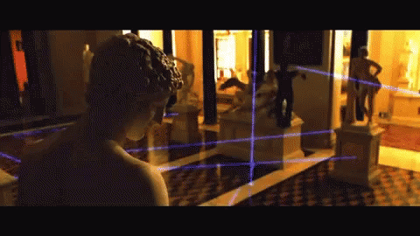
Security isn’t definitive it’s a matter of time, effort and how determined someone is.

Slide 7

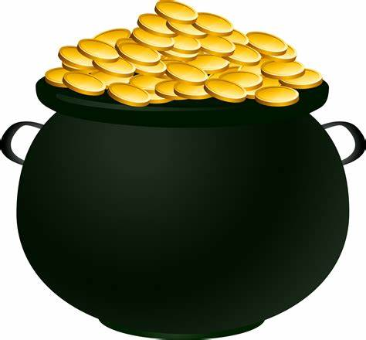
Multiple Lines Of Defense

Slide 8
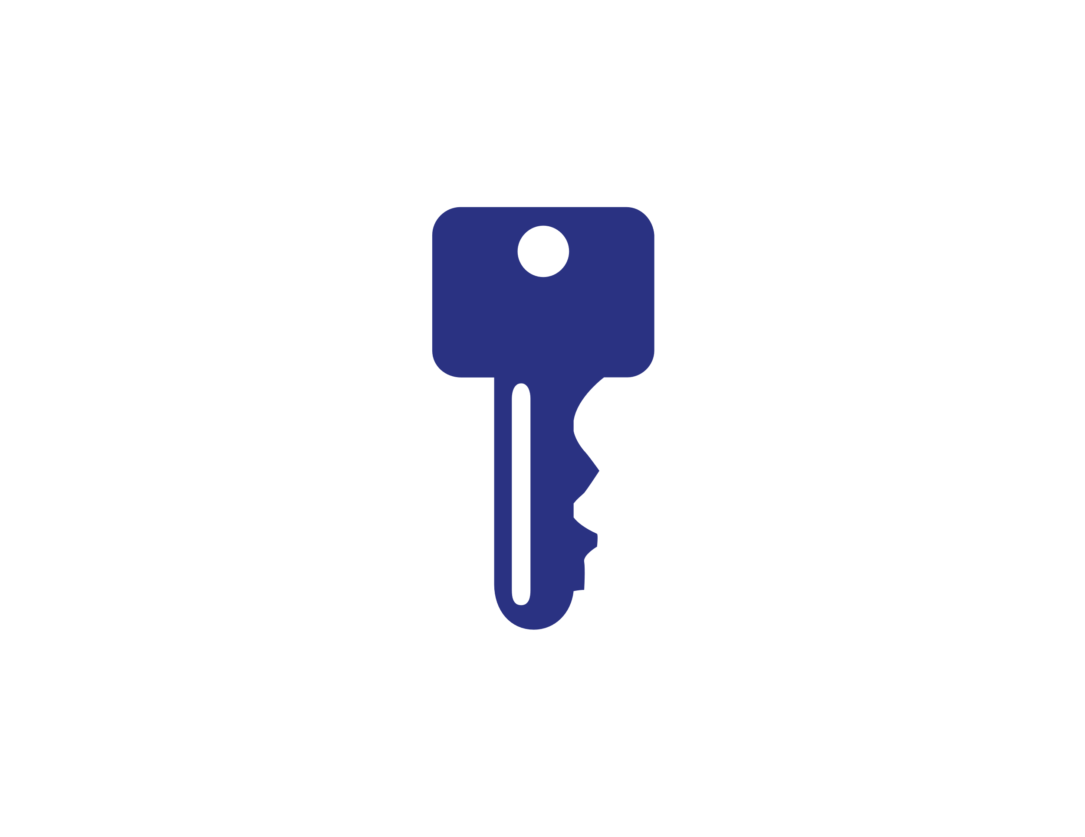

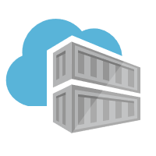


Authentication & Authorization
Require the most stringent authentication
Users – 2fa
Services – rotatable, revocable, time-based tokens
Provide the least permissions required to get the job done.
Runtime clusters should only be able to pull
CI Systems should be able to push
Teams & clusters should have different permissions
Who can sign images?
Authentication:
Username/Password?
2FA
Token
Certificate
Time based
Revocable?
Permissions:
Read – Pull
Write – Push
Sign – content trust
List – repos and tags
Delete
Update meta-data – expiration date
Users
Services

Slide 9

Managing Base Images

Slide 10

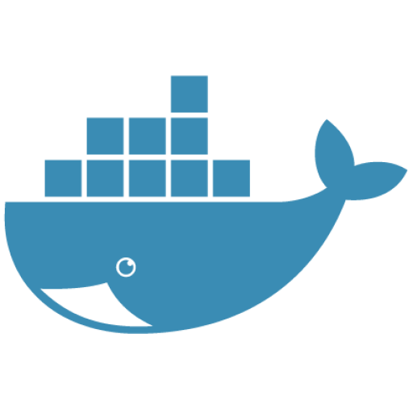

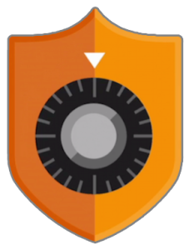


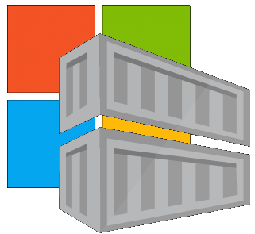



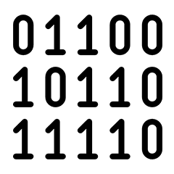
Are Your Base Images Secure?
Buffer base artifacts in your secured environment
Scan, test, validate base artifacts
Automate all of this
Be protected and available, when things outside your control aren’t secured or available
Are Your Base Images Artifacts Secure?
Public Registries
Your Environment
aws, azure, google, on-prem, …
Private Registry
acr, ecr, gcr, dtr, harbor, jfrog, …
.NET
contoso.azurecr.io
Docker Hub
Public Internet
staging-artifacts
node
java
MCR
dotnet
ACR Tasks
wordpress
base-artifacts
node
java
dotnet
wordpress
departments
marketing
warranty
dev
falcon-team
warriors-team

Slide 11
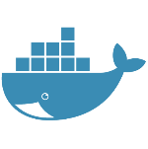





Automating Base Image Updates
Public Registries
Your Environment
demo42.azurecr.io/hub
Private Registry
demo42.azurecr.io
Docker Hub
Public Internet
Task Image Validation
node
java
MCR
dotnet
ACR Tasks
wordpress
base-artifacts
node
java
dotnet
wordpress
dev
faclon-team
Helloworld digest: 91e
warriors-team

Slide 12




Are Your Base Artifacts Secure?
Images Secure?
Public Registries
Your Environment
aws, azure, google, on-prem, …
FROM demo42.azurecr.io/base-artifacts/dotnet/core/runtime:2.1.10 AS base
WORKDIR /app
FROM demo42.azurecr.io/base-artifacts/dotnet/core/sdk:2.1 AS build
WORKDIR /src
COPY src/Important/Important.csproj src/Important/
RUN dotnet restore src/Important/Important.csproj
COPY . .
WORKDIR /src/src/Important
RUN dotnet build Important.csproj -c Release -o /app
FROM build AS publish
RUN dotnet publish Important.csproj -c Release -o /app
FROM base AS final
WORKDIR /app
COPY --from=publish /app .
ENV VERSION=0.0.25
ENTRYPOINT ["dotnet", "Important.dll"]
FROM microsoft/dotnet/core/runtime:2.1.10 AS base
WORKDIR /app
FROM microsoft/dotnet/core/sdk:2.1 AS build
WORKDIR /src
COPY src/Important/Important.csproj src/Important/
RUN dotnet restore src/Important/Important.csproj
COPY . .
WORKDIR /src/src/Important
RUN dotnet build Important.csproj -c Release -o /app
FROM build AS publish
RUN dotnet publish Important.csproj -c Release -o /app
FROM base AS final
WORKDIR /app
COPY --from=publish /app .
ENV VERSION=0.0.25
ENTRYPOINT ["dotnet", "Important.dll"]
FROM mcr.microsoft.com/dotnet/core/runtime:2.1.10 AS base
Private Registry
acr, ecr, gcr, dtr, harbor, jfrog, …
.NET
demo42.azurecr.io
Docker Hub
FROM mcr.microsoft.com/dotnet/core/sdk:2.1 AS build
Public Internet
Task Image Validation
node
java
MCR
dotnet
ACR Tasks
wordpress
base-artifacts
node
Red Hat
java
dotnet
gcr
wordpress
dev
faclon-team
warriors-team
SCC
Source Code ControL
gpr

Slide 13
Automating Base Artifact Updates
Public Registries
Your Environment
demo42.azurecr.io/hub
Private Registry
demo42.azurecr.io
Docker Hub
Public Internet
Task Image Validation
node
java
MCR
dotnet
ACR Tasks
wordpress
base-artifacts
node
java
dotnet
wordpress
dev
faclon-team
warriors-team
SCC
Source Code ControL

Slide 14
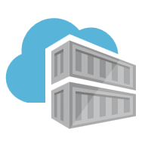
ACR Tasks A primitive of container lifecycle management
Build, Patch, Manage Container Artifacts
aka.ms/acr/tasks

Slide 15



Dockerfile FROM
ACR Tasks
Functional Tests
Base Images
Commit Id
Id
Context
Dependencies
ACR
d5ab1fa
fx:1
fx:1^{(a)}
fx:1
Web-Build
1
fx:1
web:sha@la
web:1
deploy/test
deploy
web:1
web:1
test:t
Context
d5ab1fa
test:1
Dependencies
web:1
Integration Env
FROM jenga.azurecr.io/baseimages/fx:1
COPY . /output
EXPOSE 80
ENTRYPOINT ["entryPoint"]
If docker build succeeds (including any unit tests),
Save the context & base image dependencies
web:1
az acr task create \
–n Web-Build \
–t web:${{.Run.ID}} \
–c github.com/demo42/web \
–-git-access-token $PAT \
–r jenga
Staging Env

Slide 16
Dockerfile FROM
ACR Tasks
Functional Tests
Base Images
Commit Id
Id
Context
Dependencies
ACR
fx:1^{(a)}
fx:1
d5ab1fa
Web-Build
1
fx:1
web:sha@la
web:1
deploy/test
deploy
Context
fx:1^{(b)}
fx:1^{(b)}
2
fx:1^{(b)}
web:sha@ya
web:2
deploy/test
deploy
web:2
web:2
d5ab1fa
test:2
test:2
Dependencies
fx:1^{(a)}
web:2
fx ships an OS &/or FX Patch, using the stable 1 tag
The build-task is monitoring changes based on the last build
Integration Env
Base image updates restore the previous context
If Build & Unit Tests Succeed,
Update the base image dependencies
web:2
Staging Env

Slide 17
Dockerfile FROM
ACR Tasks
Functional Tests
Base Images
Commit Id
Id
Context
Dependencies
ACR
Web-Build
fx:1
fx:1^{(a)}
fx:1
d5ab1fa
Web-Build
1
web:sha@la
web:1
deploy/test
deploy
Context
fx:1^{(b)}
fx:1^{(b)}
2
fx:1^{(b)}
web:sha@ya
web:2
deploy/test
deploy
web:2
web:2
ef26q5c
test:2
d5ab1fa
test:3
fx:2^{(d)}
fx:2^{(d)}
fx:2
ef26q5c
3
fx:2^{(d)}
web:sha@qe
web:3
deploy/test
deploy
web:3
web:3
Dependencies
test:4
Dependencies
fx:1^{(a)}
fx:1^{(b)}
web:3
FROM jenga.azurecr.io/baseimages/fx:2
COPY . /output
EXPOSE 80
ENTRYPOINT ["entryPoint"]
Integration Env
web:2
web:3
If docker build succeeds (including any unit tests),
Save the context & base image dependencies
Staging Env
Container OS & Framework Patching
With ACR Tasks

Slide 18






ACR Tasks: OS & FX Patching
Security Scanners
Triggers
AKS Central US
Image/Chart Push Webhooks
Github
Azure Repos
Regionalized Webhooks
AKS West Europe
Base Image Sources
Pipelines CD
ACR Tasks
ACR
Central US
West Europe
Brazil South
AKS Brazil South
Base Image Tracking
Australia East
Docker Hub
MCR
ACR
Run ID | Git Hash | Image Dependency | Manifest | Log
aab1 | 1b07de9 | dotnet/core/runtime:2.2 | fb443951f | {}
aab3 | dd2g98d | node:11 | 2557e3c07 | {}
A3z1 | Wfl202k | java:9 | 20ga038a0 | {}
AKS Australia East
aka.ms/acr/tasks

Slide 19


ACR Tasks: Break The Loop – OS & FX Patching
Summer ‘19
Security Scanners
Triggers
CI Solutions
AKS Central US
Image/Chart Push Webhooks
Github
Azure Repos
Regionalized Webhooks
AKS West Europe
Base Image Sources
Pipelines CD
ACR Tasks
ACR
Central US
West Europe
Brazil South
AKS Brazil South
Base Image Tracking
Australia East
Docker Hub
MCR
ACR
Run ID | Git Hash | Image Dependency | Manifest | Log
aab1 | 1b07de9 | dotnet/core/runtime:2.2 | fb443951f | {}
aab3 | dd2g98d | node:11 | 2557e3c07 | {}
A3z1 | Wfl202k | java:9 | 20ga038a0 | {}
AKS Australia East
aka.ms/acr/tasks

Slide 20
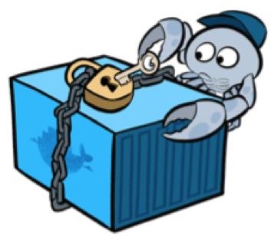
Docker Content Trust Image Signing
Assuring an image validation source to destination

Slide 21






ACR Content Trust
Content Trust Preview added September ’18, now GA
Images signed at the source, stored in ACR, validated on the client
Content Trust based on the source, not the actual content
We need a signing of actual content solution
Some work in progress
docker push
docker pull
acr
 Content Trust Enabled,
api
api
Images
Signatures

Slide 22
Container Workflows…

Slide 23
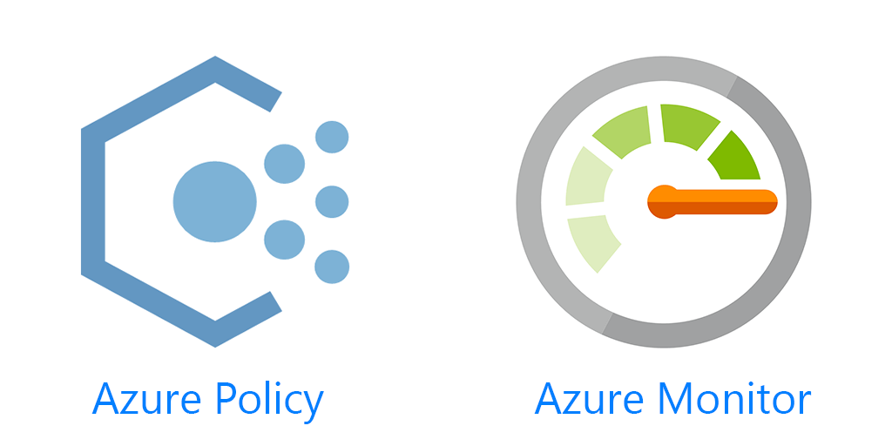




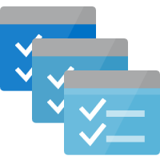

Container Lifecycle Primitives
Host agents monitor, protect and report running containers
3
Applying multiple lines of defense
Runtime scanning, everywhere you can
Apply policy to restrict images to secured registries
Quarantine images, until scanned and secured
Kubernetes Service
Source Code Control
(SCC)
Build/CI,
Integrate,
Test
CD, Deploy
Container Instances
7
Upon release, set released flag in ACR (ACR-Auto-purge policies)
App Services
.NET
Base Image Index
6
4
Service Fabric
8
1
2
Docker Hub
ACR Tasks
ACR
Functions
Azure Container Registry
Microsoft Container Registry
IoT
Inner-Loop
Image Security Scanning
Secure by default with by Quarantin-ing artifacts
Run
Batch
5
Code
Validate
Debug

Slide 24
Container Registries Secured by Default
Assuring a registry has images that are scanned and considered secure enough
The Container Quarantine Pattern

Slide 25
Secured By Default
Build/Push
Azure Container Registry
Container Hosts
Quarantine Tag
Digest
Tag
91efj6
:1.0
:1.1
u82lq
:1.2
e8s1f

Slide 26
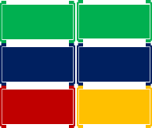
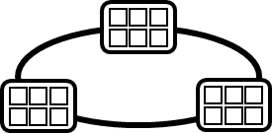
Container Service
Run, Manage
1
Release Management
Container Instances
docker push acrdemos.azurecr.io/th:1.0
Azure Container Registry
Production
environments
Lock down images that are vulnerable
Secure registries by default
Protect unprotected nodes – like developers
App Services
5
6
2
{
"id": "0d799b14-404b-4859-b2f6-50c5ee2a2c3a",
"timestamp": "2018-02-28T00:42:54.4509516Z",
"action": "push-quarantined",
"target": {
"size": 1791,
"digest": "sha256:91ef6
"length": 1791,
"repository": “th",
"tag": "1.0"},
"request": {
"id": "978fc988-1e06-49ee-bf71-4f6e331d1591",
"host": “acrdemos.azurecr.io",
"method": "PUT"}
}
{
"id": "0d799b14-404b-4859-b2f6-50c5ee2a2c3a",
"timestamp": "2018-02-28T00:42:56.4509516Z",
"action": "push",
"target": {
"size": 1791,
"digest": "sha256:91ef6
"length": 1791,
"repository": “th",
"tag": "1.0"},
"request": {
"id": "978fc988-1e06-49ee-bf71-4f6e331d1591",
"host": “acrdemos.azurecr.io",
"method": "PUT"}
}
Tag
Digest
91efj6
u82lq
e8s1f
3r2s7
Quarantine Tag
:1.0
:1.1
:1.0
:1.0
3
docker pull th@sha256:91ef6
4
az acr policy set –n acrdemos --quarantine-remove –-image th@sha256:91ef6
or
az acr policy set –n acrdemos --quarantine-block –-image th@sha256:91ef6
Notes:
{
"id": "0d799b14-404b-4859-b2f6-50c5ee2a2c3a",
"timestamp": "2018-02-28T00:42:54.4509516Z",
"action": "push-quarantined",
"target": {
"mediaType": "application/vnd.docker.distribution.manifest.v2+json",
"size": 1791,
"digest": "sha256:91ef6
"length": 1791,
"repository": “th",
"tag": "1.0"
},
"request": {
"id": "978fc988-1e06-49ee-bf71-4f6e331d1591",
"host": "jengademos.azurecr-test.io",
"method": "PUT",
"useragent": "docker/18.03.0-ce-rc1 go/go1.9.4 git-commit/c160c73 kernel/4.9.75-linuxkit-aufs os/linux arch/amd64 UpstreamClient(Docker-Client/18.03.0-ce-rc1 \\(windows\\))"
}
}

Slide 27

VNET & Firewalls
Securing registry access to private virtual networks

Slide 28
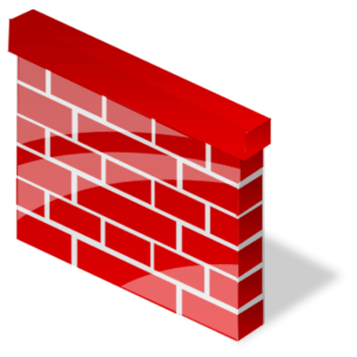

VNet & Firewall Rules
Is authentication & authorization enough?
Least required privileges apply to the network as well
Registries in the Vnet
Whitelist IP ranges that should have access
AKS
Public Internet
Node1
Node2
Node3
Azure virtual network
Azure virtual network
IP: 5.5.1.2
Rules
ACR
Other Resources
IP: 10.2.1.3
IP: 5.5.1.2
IP: 10.2.1.3
http://aka.ms/acr/vnet

Slide 29
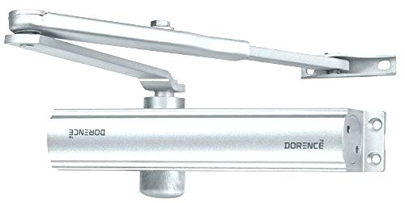

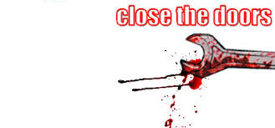
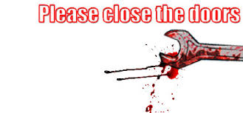

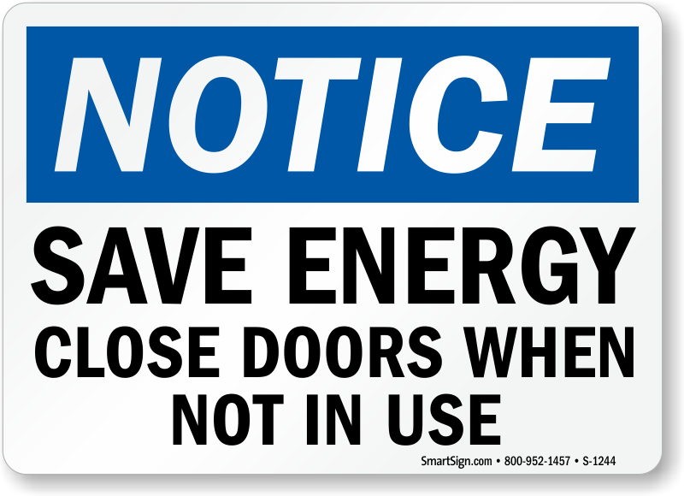
Policy & User Experience
Engage the good people to help with policy
Make it easy to do the right thing
…difficult to do the wrong thing
KEEP US SECURE
Lock Doors Upon Leaving

Slide 30
Wrapping up
Security isn’t just one thing
Predict what’s possible, not just what’s happened
Apply minimal privileges and access, balancing users needs
Protect from the bad people, enable the good people
Don’t wait for the aftermath cleanup
Enforce policy for where to pull images
Scan & secure base images
Scan & secure your images
Secure nodes
Keep scanning images for new vulnerabilities
Monitor network traffic, not just static images

Slide 31
Thank You
stevelasker.blog
Choosing a Docker Registry, and other topics
aka.ms/acr/Quarantine
Quarantine Pattern
Steve Lasker
Program Manager
Azure Container Registries
Steve.Lasker@Microsoft.com
@SteveLasker
SteveLasker.blog
github.com/SteveLasker
github.com/SteveLasker/presentations

